Slide 1
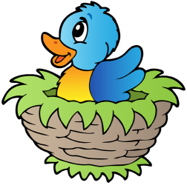
A Young Bird project
Structure Programming II Project .

Slide 2
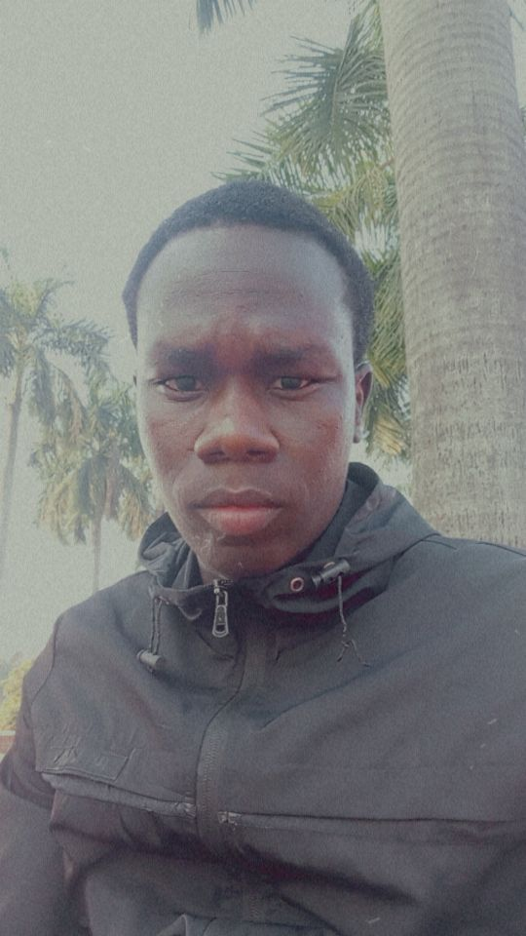
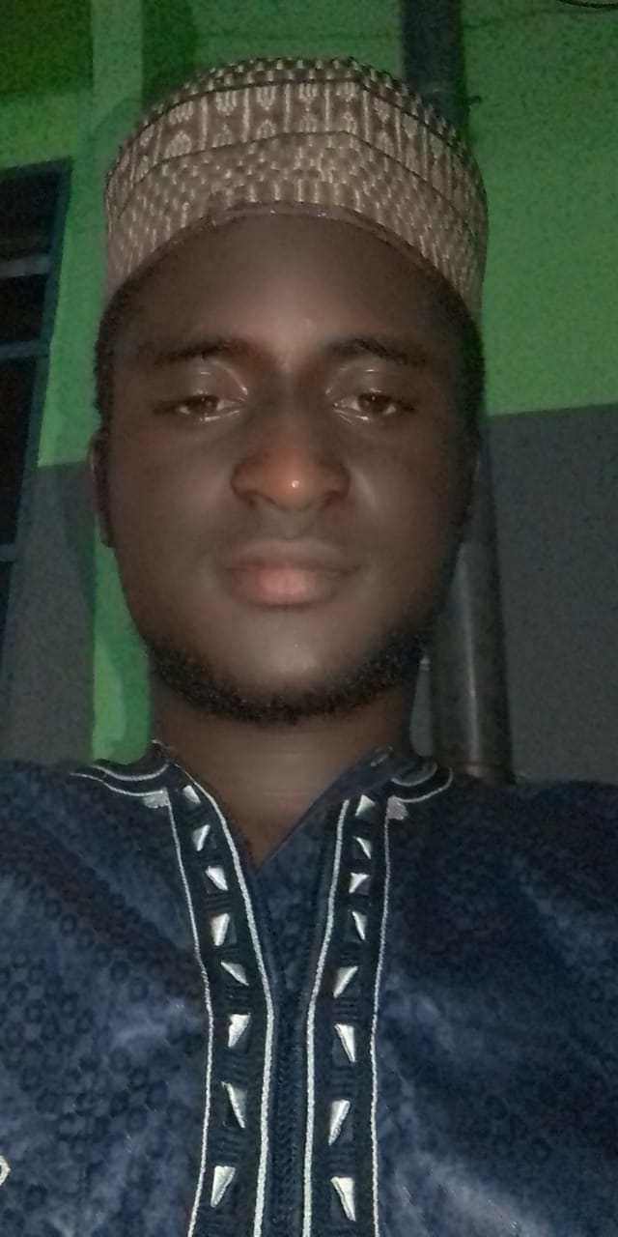
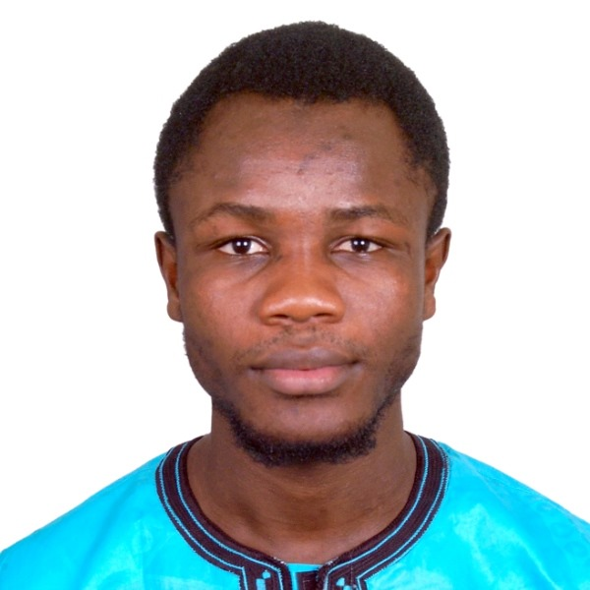
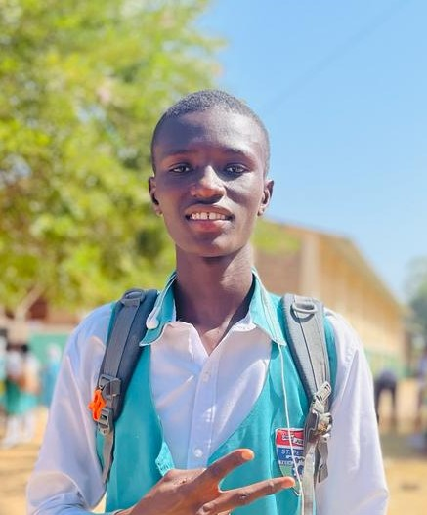
Team Members
Wirba Ashraf Djauro
Limassou Haman Bello
Katim Gaye
Elhadj Ibrahima Camara

Slide 3
What’s « Young bird » About !
Welcome to our "Young Bird" SDL2 project! Using the C programming language we're crafting a captivating gaming experience where players navigate the skies as a fledgling bird while avoiding obstacles.

Slide 4
What inspired us ?
Recalling when we first saw "Young Bird " game , Let's write some code for that marvel. We aim to bring back the excitement of flight with each line, motivating gamers everywhere. Together, we can inspire creativity and bring everyone's attention to the wonders of flying.

Slide 5
Game Features :
The game continues indefinitely, with the goal being to achieve the highest score possible.
The game view moves to the right creating a horizontal movement simulation, and the player controls the bird's vertical movement.
Single Tap Control: Tapping the screen makes the bird flap its wings and ascend slightly.
Gravity: The bird constantly falls due to gravity, requiring continuous tapping to maintain altitude.
Obstacles: The bird must navigate between pairs of green pipes with gaps at varying heights. Colliding with pipes or the ground ends the game.
Scoring: Each successful passage through a pair of pipes earns one point.

Slide 6
Additional Features
1- Weather Effects: Introduce dynamic weather conditions such as rain, wind, or storms, affecting the bird's flight and visibility.
2- Day-Night Cycle: Implement a day-night cycle, offering different challenges and visuals depending on the time of day.
3- Power-ups: Introduce power-ups like speed boosts, temporary invincibility, or score multipliers to add excitement and strategic depth.
4- Customization: Allow players to customize their bird's appearance, colors, and accessories for personalization.
5- Achievements and Leaderboards: Include achievements to unlock and leaderboards to compare scores with other players, adding replay value.
6- Story Mode: Develop a narrative-driven story mode with missions, characters, and plot twists to engage players.

Slide 7
Tools & Technologies :
1- Programming Language : C programming language .
2- Graphics library : SDL2 .
3- Audio library : SDL2_mixer .
4- Image library : SDL2_image .
5- Common libraries :
stdio.h ;
stdbool ;
stdlib.h ;
time.h ;
math.h ;
6- IDE (Integrated Development Environment): Code::Bloks 20.03
7- Graphics Editing Software: Paint ,GIMP.
8- Audio software : Bfxr .

Slide 8
Task Distribution :
Game Design:
Conceptualize levels, and progression. ( Ashraf )
Design the visual style, characters, and environments. ( Katim )
Create the storyline and narrative elements if applicable (Haman )
Create sprite animations for the bird character, obstacles, and environmental elements. (Ashraf )
Design backgrounds, landscapes, and visual effects. ( Haman )
Develop user interface elements such as menus, buttons, and icons. (Haman )
Programming:
Implement game mechanics such as bird movement, collision detection, and scoring. ( Ashraf , Haman )
Integrate SDL library for graphics, audio, and input handling. (Katim)
Handle game state management, user input implementation, and menu systems. (Katim , Ashraf )

Slide 9
THANK YOU !

